Slide 1
VSys Voices Is Everyone Welcome? Tools to Broaden Volunteer Engagement
Notes:
DANA: Welcome, we are recording. Thank you for joining us for this important session. We’ll have at least 10 minutes, maybe 15, for open discussion and demo of some of these tools near the end of the presentation. Feel free to share comments and questions in the chat as we go, too!

Slide 2
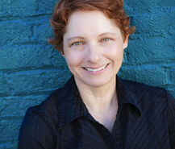
VSys Voices Presenters
Dana Litwin, CVA, is a globally recognized strategic advisor, speaker, and advocate for civic service. Since 2002 she has guided organizations nationwide to produce breakthrough volunteer and community engagement programs. Dana is the creator of the YouTube channel “Priceless Advice for Leaders of Volunteers”. She served as President of the Association of Leaders in Volunteer Engagement (AL!VE) and is a founder of the National Alliance for Volunteer Engagement. Learn more at danalitwinconsulting.com.
Todd McMullin graduated in non-profit management and has 25 years experience as a technology consultant for community organizations. He is the co-founder of a United Way chapter, a local Volunteer Center, Samaritan Technologies, The Disaster Help Network, The Congress of Volunteer Association Administrators and the Association of Leaders in Volunteer Engagement (AL!VE).
Notes:
TODD kicks off webinar.

Slide 3
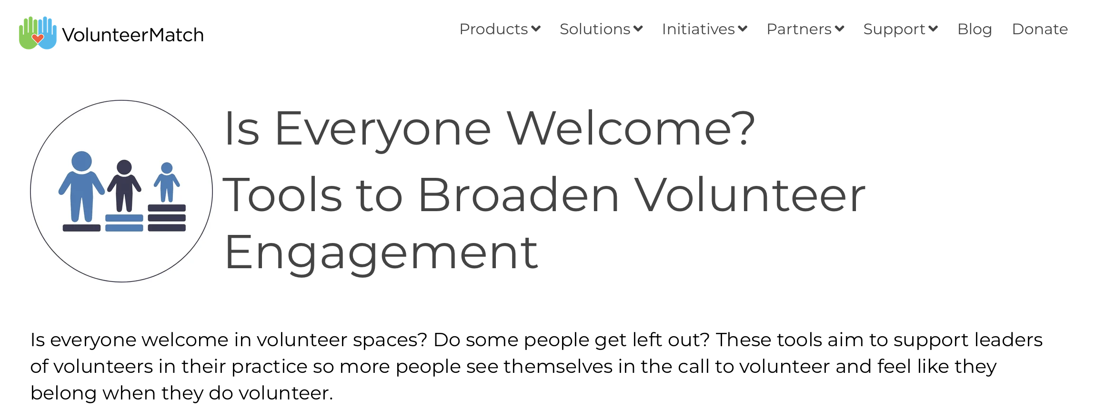
Is Everyone Welcome?
learn.volunteermatch.org/is-everyone-welcome
Notes:
TODD

Slide 4
Today’s Learning Objectives
Background on the toolkit and ADEVI research
What types of tools and topics
How to use the toolkit
Notes:
TODD: We have a few goals for today:
(READ SLIDE)

Slide 5
Barriers to Welcoming Volunteers
Lack of accessibility awareness.
Stereotyping, biases, and prejudice.
Resistance to change.
Language and communication barriers.
Inadequate training and resources.
Org budget and investment in volunteer services.
Notes:
TODD (read slide), share a few examples.
[Todd can reiterate story from February webinar, about personal prejudices and resistance to change. Also reference the other stories and the webinar itself.]

Slide 6
Poll Question
“What is holding you back from implementing more equitable practices in your work with volunteers?”
Notes:
Lisa launch Poll

Slide 7
Target Audience for Today’s Webinar
SKILL LEVEL
Minimal Knowledge
Looking for some basic information, key principles and “how-to’s” on the subject.
Working Knowledge
Integrated practices and moving beyond basic concepts. Looking for breadth and depth on a topic
Authoritative Knowledge
Looking for advanced knowledge, integration and concepts that are innovative and cutting edge.
Notes:
TODD:
Our target audience today is Everyone. A working knowledge is helpful to incorporate the ideas to action for welcoming a wide variety of volunteers into your organization.

Slide 8
Developing This Free Toolkit
ADEVI Research Year 2 toolkit based on ADEVI Research Year 1 results.
Lead by CCVA ED Faiza Venzant & Prof. Mark Hager, ASU.
Toolkit hosted on VolunteerMatch.

Slide 9
Developing This Free Toolkit
First set of tools launched October 2024.
More tools in development.
Created by 26 volunteer CVAs with 2 ASU graduate students assisting.

Slide 10
Developing This Free Toolkit
6 Working Groups:
Planning & Advocacy for Volunteer Involvement
Attracting & Onboarding A Volunteer Workforce
Preparing Volunteers for Their Roles
Documenting Volunteer Involvement
Managing Volunteer Performance
Acknowledge, Sustain, and Celebrate Volunteer Involvement
Notes:
DANA
My working group developed tools for Planning and Advocacy, more internal policies and practices for leaders of volunteers.

Slide 11
Research and Toolkit Goals
Broader access to volunteer opportunities.
Support inclusive volunteer engagement practices.

Slide 12
What Types of Tools?
Templates
Tables
Worksheets
Questionaires
Sample Policy Text
Videos

Slide 13
Inside the Toolkit
PLANNING FOR VOLUNTEERS
A Guide for Creating Inclusive Volunteer Position Descriptions.
Broadening Access to Volunteer Opportunities: Things to Consider.
Equity Practice Framework.

Slide 14
Inside the Toolkit
PLANNING FOR VOLUNTEERS
Guiding Questions for Equitable Community Collaboration
Guiding Questions for Equity and Inclusion in Volunteer Engagement
Inclusive Volunteer Recruitment Guide
Visualizing Equity

Slide 15
Inside the Toolkit
PREPARING VOLUNTEERS
Accessibility Considerations When Partnering with Volunteers.
Checklist for Training Volunteers Around Equity and Inclusion.

Slide 16
Inside the Toolkit
PREPARING VOLUNTEERS
Getting to Know Volunteers Through Values-Based Questions.
Volunteer Training Formats: Strengths and Limitations Guide.

Slide 17
Inside the Toolkit
BUILDING VOLUNTEER RELATIONSHIPS
Defining Retention Worksheet.
Volunteer Motivation Questionnaire.

Slide 18
Equity Framework Tool

Slide 19
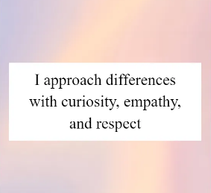
Understanding Volunteers’ Personal Values & Identity
Notes:
TODD
This work begins with curiosity and respect; If you don’t ask, you don’t know! Todd, I know you found the Identity Signs video very useful.
https://app-na1.hubspotdocuments.com/documents/7138095/view/972916846?accessId=2ead9c
Identity Signs training video (60 minutes with Jennifer Bennett and Faiza Venzant:
https://solutions.volunteermatch.org/hubfs/Equity%20In%20Action%20Toolkit/Building%20Volunteer%20Relationships/Are%20You%20Ready%20for%20Equity_%20Navigating%20biases%20in%20volunteer%20engagement.mp4?hsLang=en

Slide 20
Ideas to Action

Slide 21
How to Make the Toolkit Work for You
Make It A Team Effort:
Guiding Questions for Equity and Inclusion in Volunteer Engagement
Take Stock:
Equity Practice Framework
Notes:
This model measures a country based on certain social preferences that surround power. We call these contexts.
Equalitarian societies believe you work together to make decisions. They believe the boss is really the leader who listens to their team. A more hierarchical organization, the boss makes decisions, often without consulting the team. They are the more autocratic cultures like we often see in the Middle East.
In a collectivist culture the GROUP is more important than the individual. An example of this is China. The USA is considered more Individualistic.
Some cultures are more comfortable with risk, others aren’t. In a culture that is uncomfortable with uncertainty, people want very clear directions.
Feminist countries like Sweden invest way more in social supports whereas more masculine societies that feel everyone should look out for themselves.
In a short term oriented culture people think in the short term of when things will get done. They expect fast results. In a long term culture people are taught to think of the future. Think of China with their 5 year plans vs. the USA that tries to make immediate changes.

Slide 22
How to Make the Toolkit Work for You
Enhance Your Current Practice:
A Guide for Creating Inclusive Position Descriptions
Be Curious And Intentional:
Block out 30 minutes once a week to dive into a tool.
Notes:
This model measures a country based on certain social preferences that surround power. We call these contexts.
Equalitarian societies believe you work together to make decisions. They believe the boss is really the leader who listens to their team. A more hierarchical organization, the boss makes decisions, often without consulting the team. They are the more autocratic cultures like we often see in the Middle East.
In a collectivist culture the GROUP is more important than the individual. An example of this is China. The USA is considered more Individualistic.
Some cultures are more comfortable with risk, others aren’t. In a culture that is uncomfortable with uncertainty, people want very clear directions.
Feminist countries like Sweden invest way more in social supports whereas more masculine societies that feel everyone should look out for themselves.
In a short term oriented culture people think in the short term of when things will get done. They expect fast results. In a long term culture people are taught to think of the future. Think of China with their 5 year plans vs. the USA that tries to make immediate changes.

Slide 23
In Summary: Lessons Learned
There is no one right way.
We are all learning and unlearning.
People want to tell you about themselves - Let them.
We are all at different stages of understanding this work.
Meet people where they are at.
What we DO matters.
People are being left out.
Start today!
Notes:
Just remember: variety is the spice of life. Everyone brings different strengths to the table and we need to appreciate each other. We want our volunteers, not matter who they are to feel welcome.

Slide 24
More Tools & Resources Coming Soon!
More tools being added and refined.
Video instructions for tools coming soon.
Online “Is Everyone Welcome?” event planned for Sept.25.
Dana’s Priceless Advice Interviews: Lisa Mooney, Sarah Phillippe - stay tuned for Jennifer Bennet, Lauren Loftin!

Slide 25
Resource Links
Is Everyone Welcome (Homepage)
Equity Practice Framework
Examples of Values-Based Questions
“Identity Signs” Training
Notes:
[Lisa can you please drop these in chat as well]
Homepage: https://learn.volunteermatch.org/is-everyone-welcome
Framework: https://app-na1.hubspotdocuments.com/documents/7138095/view/910359686?accessId=6729a3
Values-Based Questions: https://app-na1.hubspotdocuments.com/documents/7138095/view/972916846?accessId=2ead9c
Identity Signs: Https://solutions.volunteermatch.org/hubfs/Equity In Action Toolkit/Building Volunteer Relationships/Are You Ready for Equity_ Navigating biases in volunteer engagement.mp4?hsLang=en

Slide 26
Thank You For Joining Us
Notes:
DANA
Thank you for your time. We hope you found this information helpful. Remember that the recording of our webinar will be available towards the end of the month, in case you’d like to hear through it again, or share it with someone you know.

